Slide 1



CIS 2013 – Debugging the Income Tax program
Instructor: Stephanie Horine

Slide 2
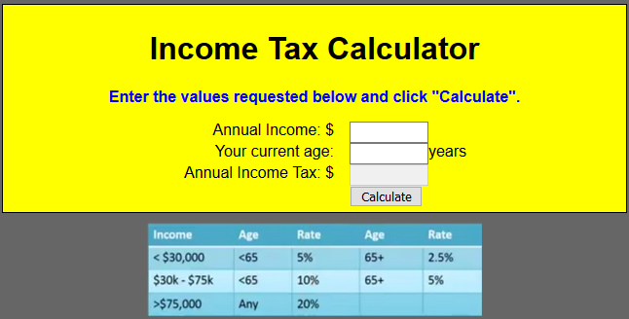
Debugging the income tax program
Go to https://tu-cis.github.io/cis-2013-starter/bad_income.html and try to run the program.
It doesn’t work no matter what values you enter or the number of times you click “Calculate”. We need to fix this program.

Slide 3

We have problems… Many problems.
As we discussed in class, debugging is part of writing programs.
In this program, depending on how you count up the changes required, there are 15-20 total errors, most of which are syntax errors.
Syntax errors are usually much easier to find than logic errors
Run your program in Firefox as we will be using Firefox developer debugging tools

Slide 4
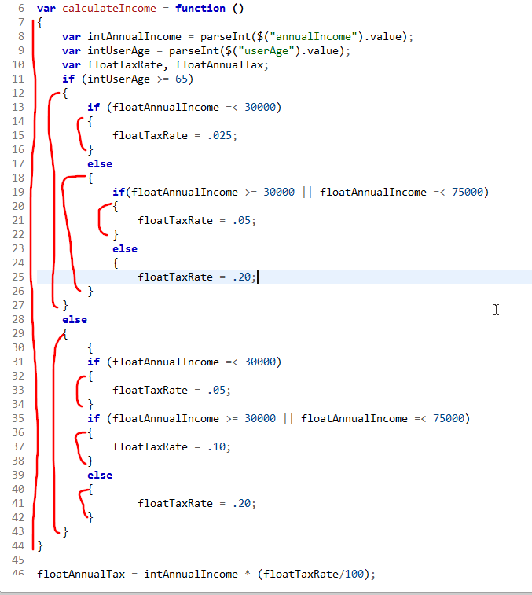
Match the { }’s
{ on line 24 has no matching }
Add one to line 26
{ on line 30 not necessary
delete it
} on line 44 appears to end the calculateIncome function prematurely
delete it

Slide 5
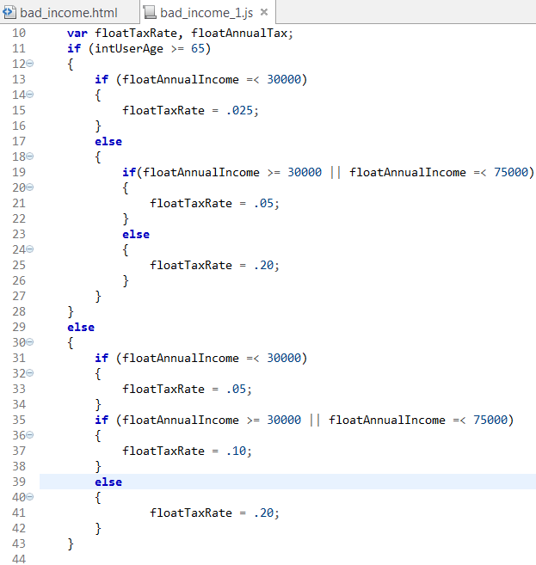
If-else statements on lines 11-28 are properly nested
If-else statements on lines 29 – 43 are not properly nested
To fix, add else statement to line 35 and properly indent, add {}’s

Slide 6
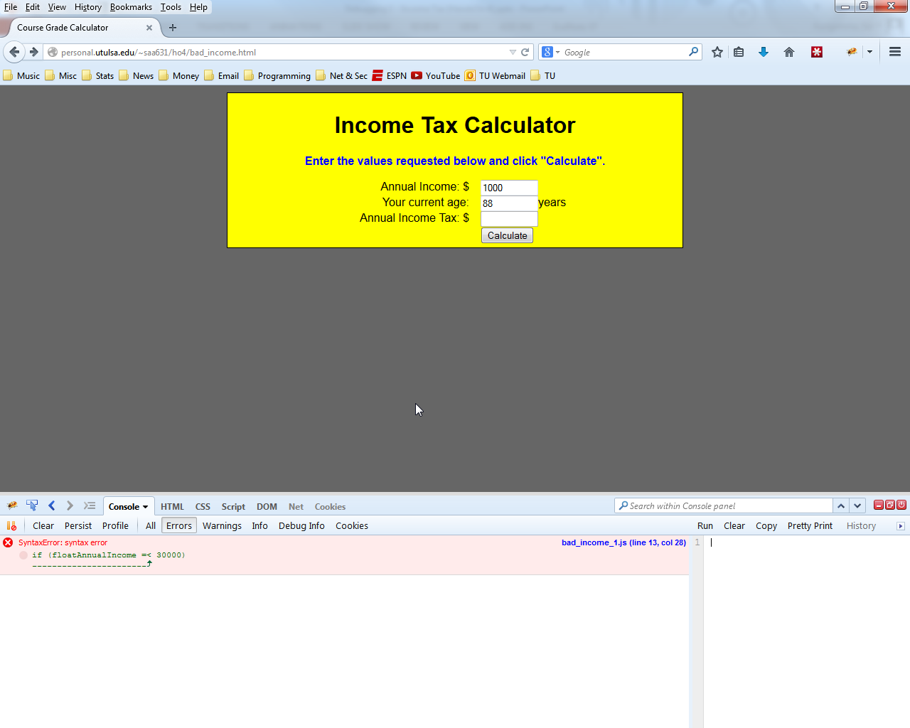
Syntax error on line 13, =< not allowed

Slide 7
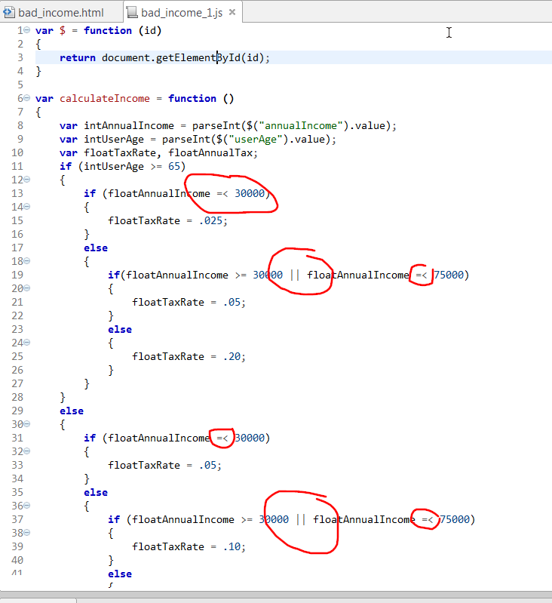
=< is unauthorized syntax; you must use <=
Fix lines 13, 19, 31, 37
Happened to notice the use of logical OR (||) when our problem logic requires AND (&&)
Note: this is a logic problem, not a syntax error, so Firebug would NOT catch it
Change || to && for lines 19 and 37

Slide 8
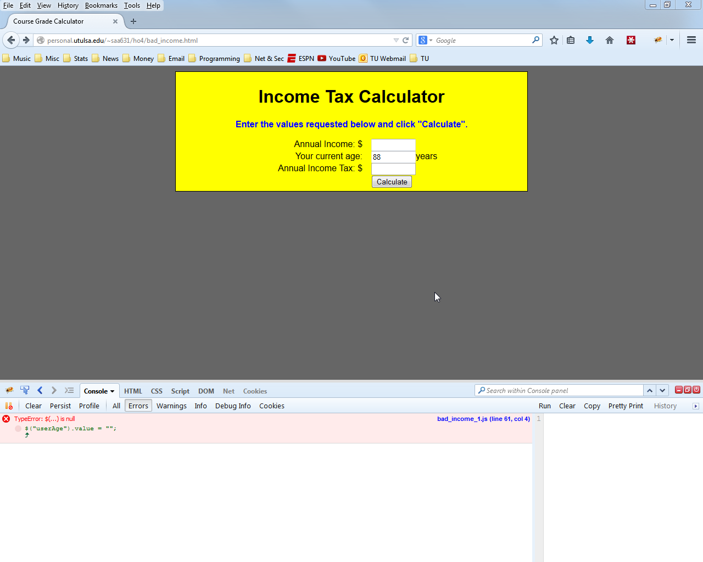
Something is wrong on line 61… let’s go look

Slide 9
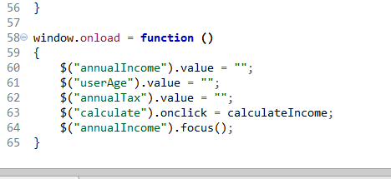
What’s the problem? Its not obvious until you look at the html page and note that there is no id called “userAge”, but there is an “age” id.
Change “userAge” to “age”

Slide 10

Another reference to the non-existent “userAge” html id… fix it on line 9 of the JavaScript file

Slide 11

floatAnnualIncome not defined?!? Let’s look at the JS file

Slide 12
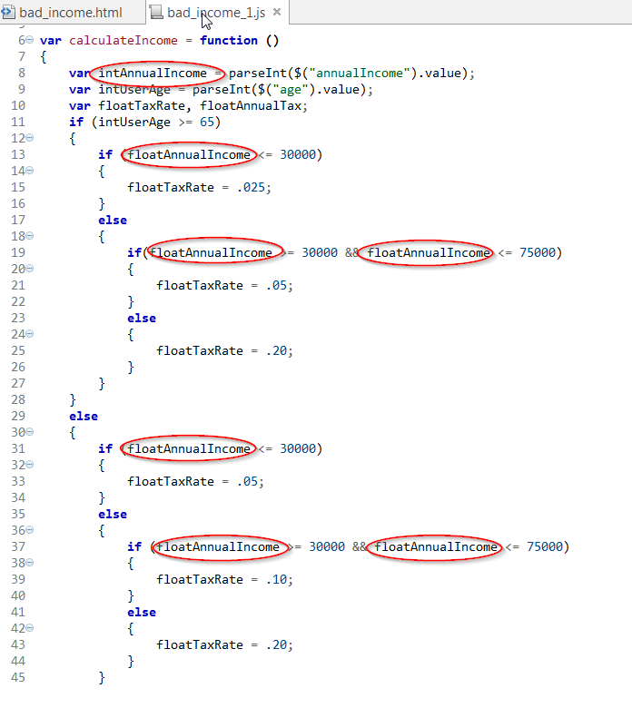
The declared variable is intAnnualIncome but the programmer used floatAnnualIncome throughout the program
Fix it… probably easier to change and declare the variable as floatAnnualIncome
Make sure you look for all intAnnualIncome’s in the program and change them

Slide 13
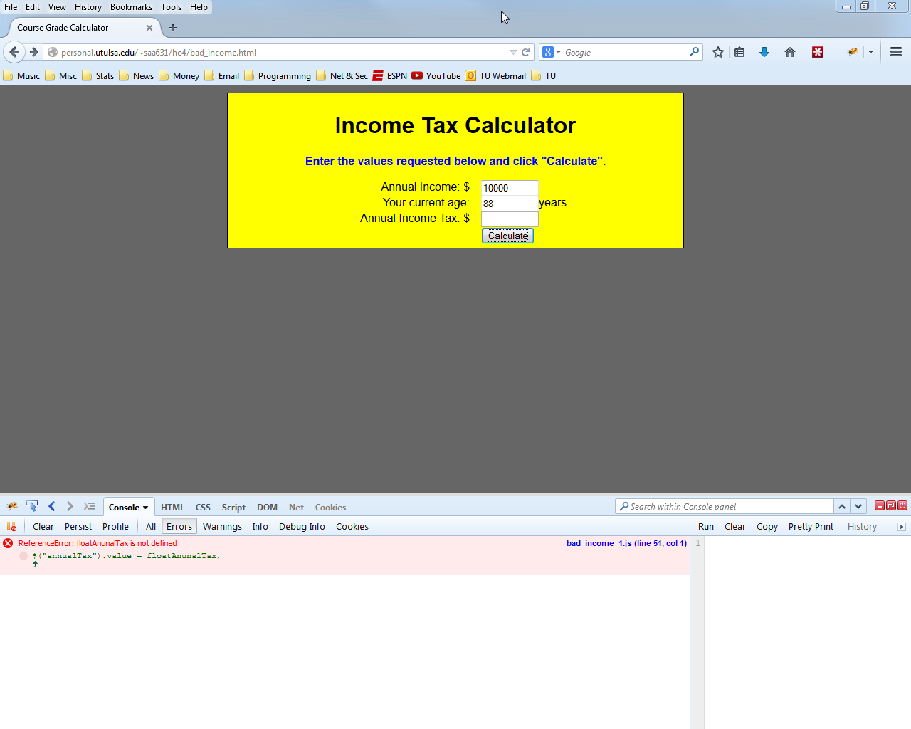
The error states: floatAnunalTax is not defined
Simple spelling error – fix it on line 51

Slide 14
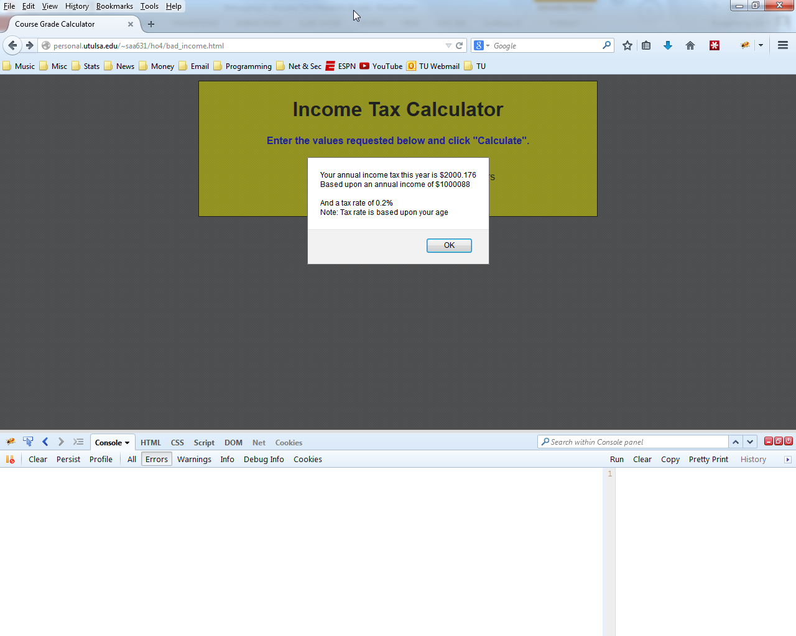
Yes! The program executed… we solved the syntax errors.
But… wait… the answer is nothing like we expected. We need to check for logic errors. Checking for logic errors is harder (unless you have written out a detailed flowchart and pseudocode, which we did, of course)

Slide 15
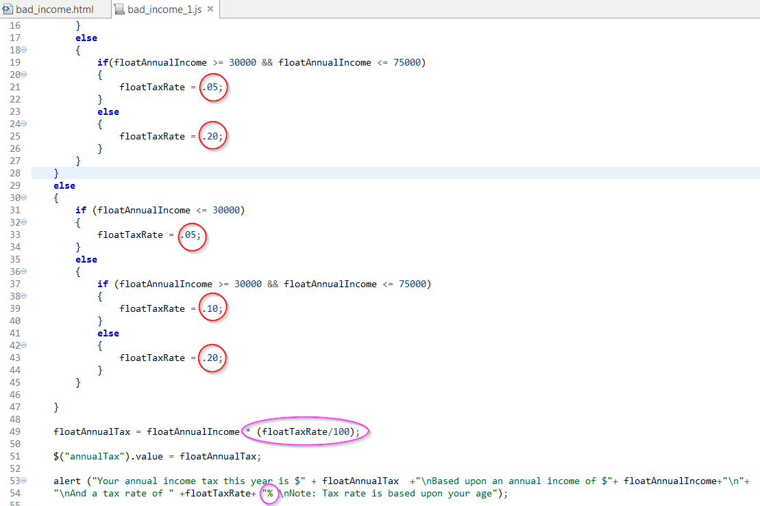
Notice that tax rate is set to its decimal equivalent (5% = .05)
Then in line 49, tax rate is divide again by 100 (not necessary the way tax rate is set
Lastly, in line 54 the output shows tax rate in %, which won’t work when using the decimal equivalent.
Solution: change tax rate to percent in lines 21, 25, 33, 39, 43 (ex .05 = 5)

Slide 16
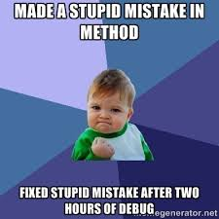
Debugged program
Syntax error types:
{} mismatches
Misspelled variable names
Trying to use non-declared variables
Improper relational operator (=< vice <=)
Logic errors:
Incorrect logical operator (|| versus &&)
Formula error

Slide 17

Firefox JavaScript debugging walkthrough
Video walkthrough of debugging this program is posted at:
https://youtu.be/3TXiCHTd6_o

Slide 18


